Slide 1
Audio Demos to the Paper Components Loss for Neural Networks in Mask-Based Speech Enhancement
Ziyi Xu, Samy Elshamy, Ziyue Zhao, Tim Fingscheidt

Slide 2


1 Introduction
We offer the following audio demos for the paper “Components Loss for Neural Networks in Mask-Based Speech Enhancement”.
All the audio demos are using files from the test dataset in the presence of pedestrian (PED) noise at 10dB signal-to-noise ratio (SNR) level. The audios include speech from both female and male test speakers.
We generate the audio demos for different parameters and . Click on the loudspeaker symbols beside the curves in Fig. 5 and the ones under TABLE Ⅱ to play the corresponding audio demos.
The equation number, table number, and figure number in these demos are referred to the corresponding equation, table, and figure in the paper, respectively.
The proposed components loss (CL) is easy to implement and code is provided at:
https://github.com/ifnspaml/Components-Loss
If you use the losses and/or the scripts in your research, please cite
@article{xu2019Comploss,
author = {Z. Xu, S. Elshamy, Z. Zhao and T. Fingscheidt},
title = {{Components Loss for Neural Networks in Mask-Based Speech Enhancement}},
journal = {arXiv preprint arXiv: 1908.05087},
year = {2019},
month = {Aug.} }
Notes:
During a communication, speech naturally come for us to pick up emotion content, since speech contains both emotion-related linguistic content, but also acoustic information.
2, SER can offer more intuitive human-to-machine interactions by allowing the machine to understand human emotions.
4, simulating or acting the emotions in a clear and natural way or getting unambiguous classes are a big challenge

Slide 3
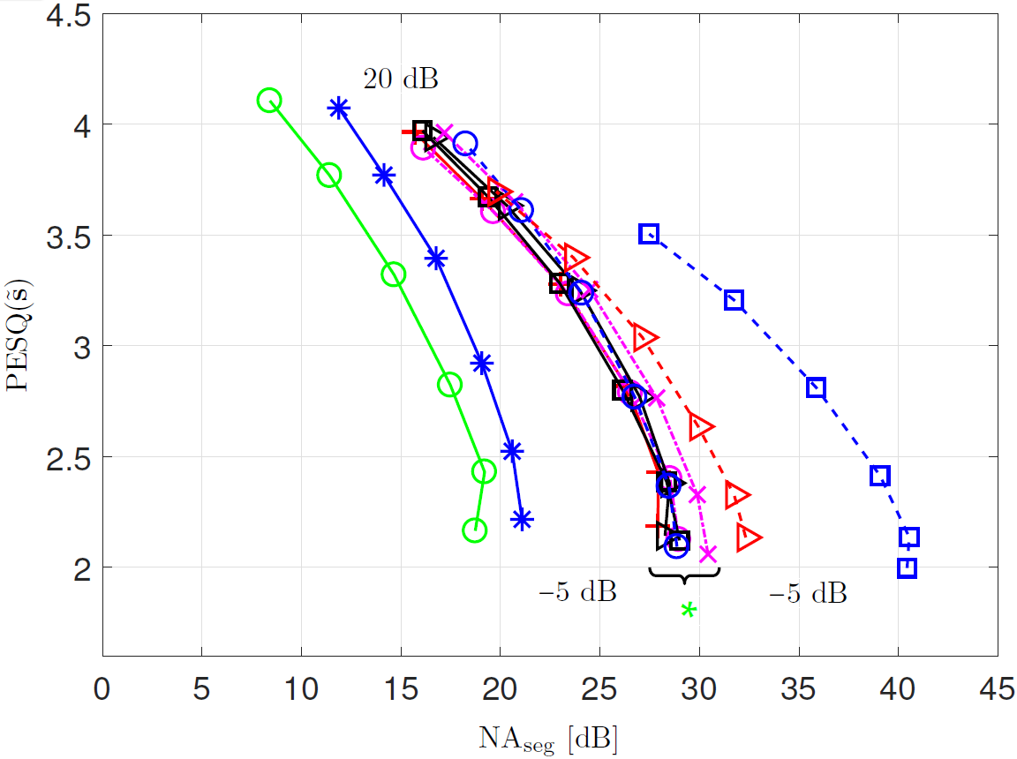
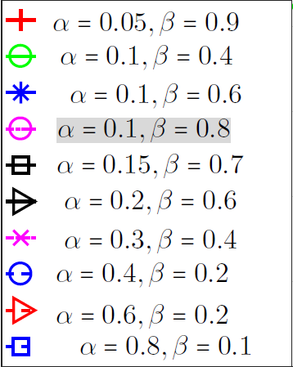

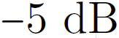
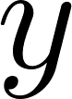


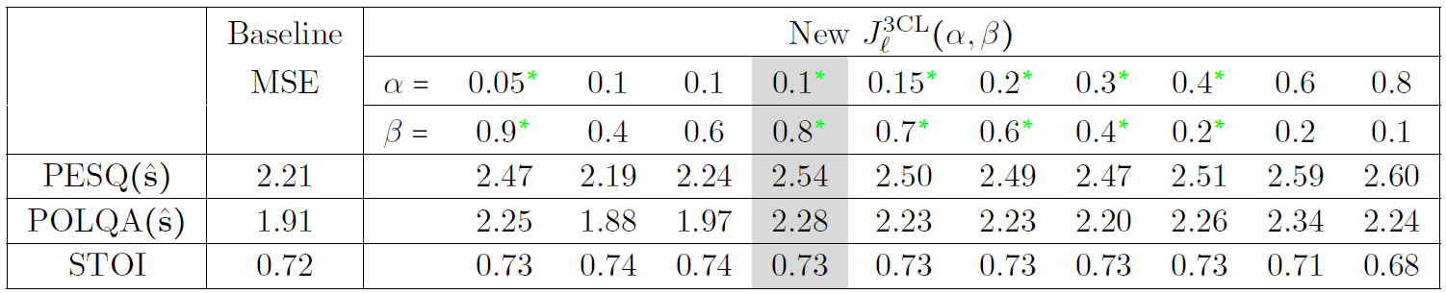










Audio Demos at SNR=10 dB
Male Test Set Speaker
Unprocessed noisy speech :
Undistorted clean speech :
Fig. 5: Noise attenuation vs. speech component quality for the new 3CL (6) on 12.5% of the validation set.
TABLE Ⅱ: Optimization of hyperparameters for the new 3CL (6) on 12.5% of the validation set.

Slide 4
Audio Demos at SNR=10 dB
Female Test Set Speaker
Unprocessed noisy speech :
Undistorted clean speech :
Fig. 5: Noise attenuation vs. speech component quality for the new 3CL (6) on 12.5% of the validation set.
TABLE Ⅱ: Optimization of hyperparameters for the new 3CL (6) on 12.5% of the validation set.

